Slide 1
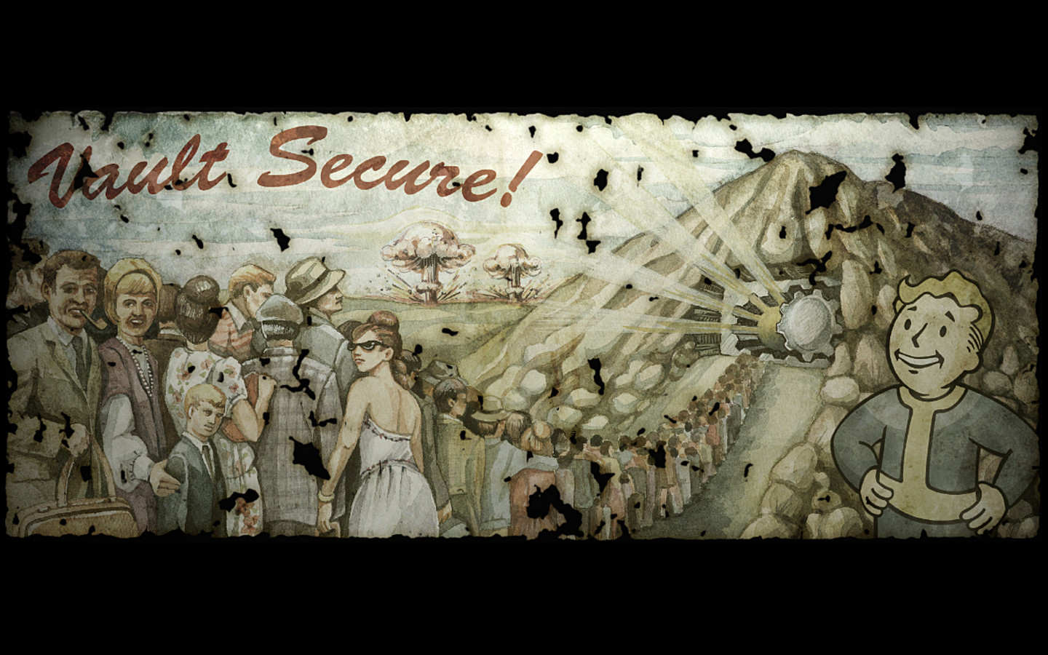
Haven
“The closest thing to heaven on Earth”
By: Julian Hernandez & Logan Ortega

Slide 2
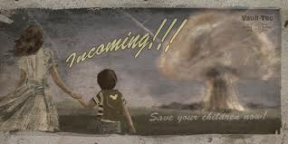
Haven’s Background
Haven was established to protect citizens from the imminent nuclear disaster, that was caused by WWIII. Haven is a large underground bunker sealed off from the destroyed remains of California by a giant vault door. Haven was one of the largest and most well supplied vaults created before the disaster. Many people live in Haven and they have a hierarchy style government, with an overseer as the king. Each citizen of Haven has to wear a special Vault uniform, and at the age of 16 each citizen is given a PIP-Boy.

Slide 3
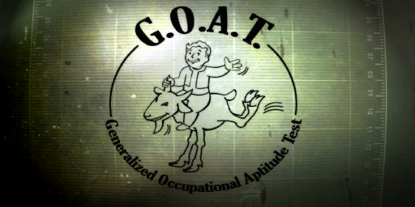
Educational system
Haven’s educational system includes studies of pre-war culture, literature, art, and government. Haven has a special test, taken at 16, that decides what job each citizen will have. The test is called Generalized Occupational Aptitude test or G.O.A.T. for short. After the results are in, the citizen is given a personal Information processor or PIP-Boy, which tell the citizens when they need to go to work, to the physician, and other important events.

Slide 4
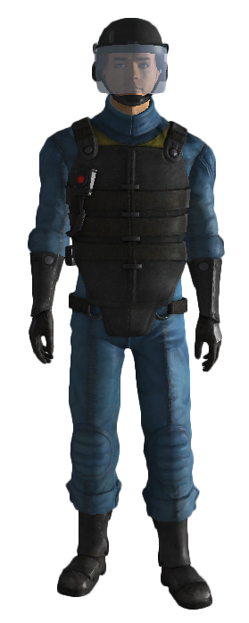
Clothing
Each citizen is given a basic vault uniform that does nothing special. But when they are given a job, the job provides them with a special vault uniform. Depending on the job depends on the ability of the suit. For example, the vault security uniform provides enhanced protection and increased melee capabilities, while the basic
uniform is just clothing.

Slide 5
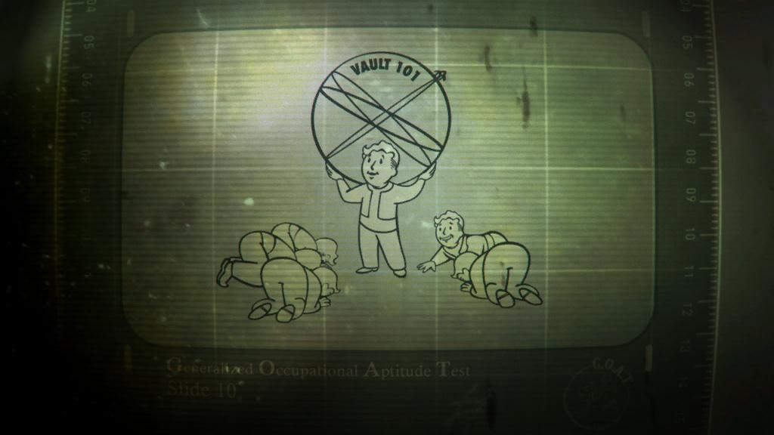
Economy
In Haven, the Overseer provides each citizen with their own food and water rations. If the citizen runs out of his/her rations before the next hand out, they can’t get any more unless they steal it or if someone gives it to them. The Overseer can deter-
mine if someone can get their
rations depending on how hard
they work.

Slide 6
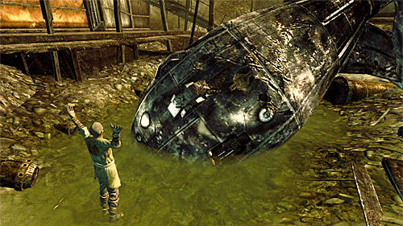
Religion
The main religion in Haven is christianity. But out in the wasteland, where some people have survived for some time, they created their own religion called the
Church of the Children of
the Atom.

Slide 7
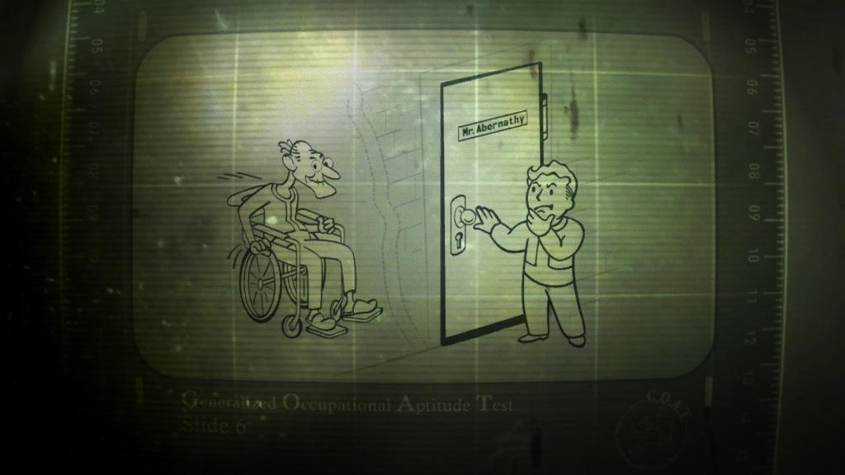
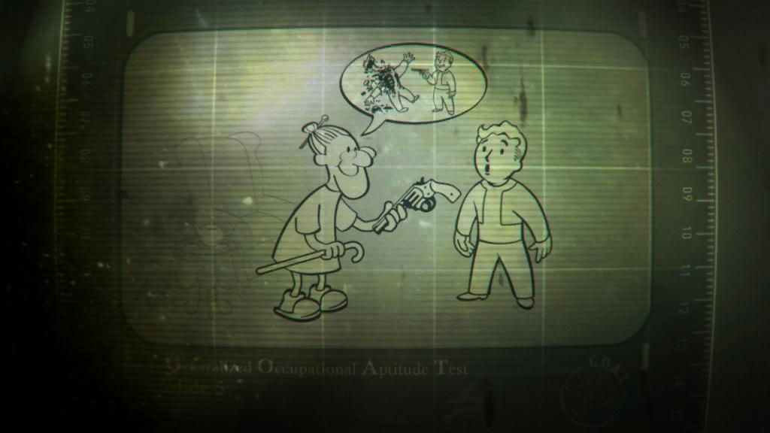
Value/Traditions
Haven’s citizens are taught at a young age to respect the overseer and their elders.

Slide 8
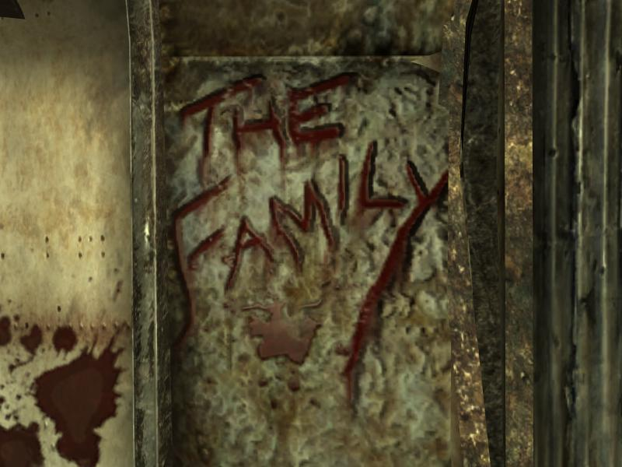
Family Roles
Haven’s families are very similar to our family life today. There is a mother and father. The only difference is that the family can only have one child. The reason for that is the rationing of food is simpler, that way
each family gets the same
amount of food and water.

