Slide 1
Gothic poetry
Year 11 English

Slide 2
Lesson Objectives
To introduce Gothic poetry and the conventions and themes represented within this genre;
To demonstrate the poetic techniques used to convey the themes and concepts common to the gothic genre of poetry;

Slide 3
Outcomes addressed
3. A student develops language relevant to the study of English.
4. A student describes and explains the ways in which language forms and features, and structures of particular texts shape meaning and influence responses.
10. A student analyses and synthesizes information and ideas from a range of texts for a variety of purposes, audiences and contexts.

Slide 4
Introduction to the Gothic Genre
The gothic genre is said to have begun with Horace Walpole’s novel The Castle of Otranto written in 1764 which was written for pure titillation.
However, through out the 19th and 20th centuries, the genre transformed from simply evoking a pleasurable terror in its readers (like the kind you get from riding a rollercoaster!) to a cultural expression of psychological and social anxieties that stemmed from many confronting changes that were going on during this time, such as the idea of evolution, changing gender roles and family ideals, new found cultural discoveries in other countries and the prevalence of new diseases.
These anxieties were expressed through various conventions and motifs that became common to the genre in novels, poetry, art and architecture.

Slide 5
Conventions of the gothic genre
THE GOTHIC LANDSCAPE/ SETTING:
wild landscapes, remote or exotic locales
dimly lit, gloomy settings
ruins or isolated crumbling castles or mansions (later cities and houses)
crypts, tombs, dungeons, torture chambers
dark towers, hidden rooms, secret corridors/passageways
unnatural acts of nature (blood-red moon, sudden fierce wind, etc.)
GOTHIC PLOT DEVICES:
dream states or nightmares
found manuscripts or artefacts
ancestral curses
family secrets
GOTHIC CHARACTERS:
‘the bleeding nun’, members of the clergy (catholic), ‘the wandering Jew’
damsels in distress, ‘fallen’ women
marvellous or mysterious creatures, monsters, spirits, vampires, werewolves, ghosts.
enigmatic figures with supernatural powers
doubles, doppelgangers, evil twins
Adapted from http://davidcwood.com/adnd/campaign/gothfiction.html

Slide 6
NEW WORDS
METONONYMY: a figure of speech in which a closely related/associated word is substituted for a object or idea
EXAMPLE:
The suits in Washington will be crying over NASDAQ results later.
-The words “suits” is related to business men or stockbrokers.
SYNECHDOCHE: a figure of speech in which a part is substituted for the whole
EXAMPLE:
Joe got some sweet new wheels for his 16th birthday.
-The word wheels is part of a car, so it refers to a car.

Slide 7
Review: Poetic Techniques
Activity: Match the following figurative language techniques to their definitions.
Technique | Definition
Metaphor | The endowment of inanimate objects or abstract concepts with animate or living qualities.
Simile | An object or action in a literary work that means more than itself, that stands for something beyond itself
Personification | A figure of speech in which a part is substituted for the whole
Allusion | A figure of speech in which a closely related term is substituted for an object or idea
Metonymy | A reference in a literary work to a person, place, or thing in history or another work of literature
Synecdoche | A comparison between essentially unlike things without an explicitly comparative word such as like or as.
Symbol | A figure of speech involving a comparison between unlike things using like, as, or as though

Slide 8
The raven, Edgar Allan poe: Poem overview.
“The Raven" is a narrative poem by American writer Edgar Allan Poe, first published in January 1845. It is often noted for its musicality, stylized language, and supernatural atmosphere. It tells of a talking raven's mysterious visit to a distraught lover, tracing the man's slow descent into madness. The lover, often identified as being a student, is lamenting the loss of his love, Lenore. Sitting on a bust of Pallas, the raven seems to further instigate his distress with its constant repetition of the word "Nevermore".

Slide 9
THE RAVEN, EDGAR ALLAN POE
The following slides show visual representations of figurative techniques used in the poem:
Your task is to identify the technique and write a short response (3- 4 sentences) about how this technique effects you as a reader.
Questions to consider in your response:
What other images does this line and image conjure in your mind?
What associations do you make with this image?
What tone/ atmosphere does this image evoke?
Which gothic conventions does this image represent?

Slide 10
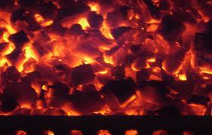
the raven, EDGAR ALLAN POE
“Ah, distinctly I remember it was a bleak December,
And each separate dying ember wrought it’s ghost upon the floor”

Slide 11
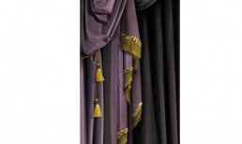
THE RAVEN, EDGAR ALLAN POE
“And the silken sad uncertain rustling of each purple curtain
Thrilled me – filled me with fantastic terrors never felt before”

Slide 12
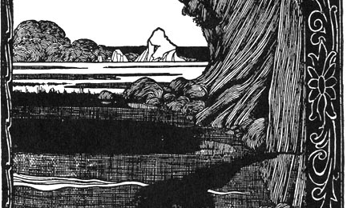
THE RAVEN, EDGAR ALLAN POE
“Ghastly grim and ancient raven wandering from the Nightly shore –
Tell me what thy lordly name is on the Night’s Plutonian shore!”

Slide 13
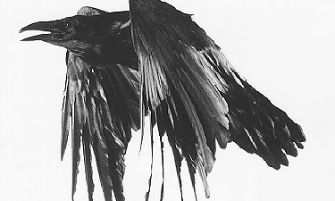
THE RAVEN, EDGAR ALLAN POE
“’Prophet!’ said I, ‘thing of evil! – prophet still, if bird or devil!”

Slide 14
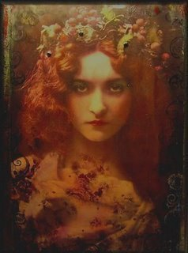
THE RAVEN, EDGAR ALLAN POE
“Clasp a rare and radiant maiden whom the angels name Lenore”

Slide 15
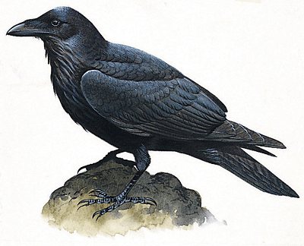
THE RAVEN, EDGAR ALLAN POE
“Take thy beak from out my heart, and take thy form from off my door!
Quoth the Raven, ‘Nevermore’.”

Slide 16
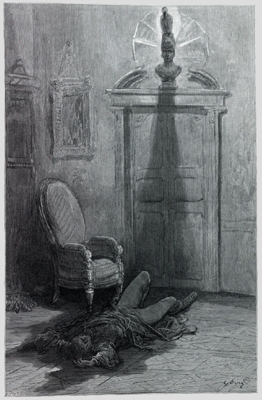
THE RAVEN, EDGAR ALLAN POE
“And my soul from out that shadow that lies floating on the floor
Shall be lifted – nevermore!”

Slide 17
Task
Create a short narrative from this poem. The narrative is to be accompanied by a visual representation in the form of a photo/ picture story set out on PowerPoint, which will be presented to the class.

Slide 18
References:
Edgar Allan Poe. Retrieved 1st November 2011 from http://en.wikipedia.org/wiki/Edgar_Allan_Poe
Glossary of Poetic Terms. Retrieved 1st November 2011 from http://highered.mcgraw-hill.com/sites/0072405228/student_view0/poetic_glossary.html#metonymy
Introduction to Gothic Fiction. Retrieved 1st November 2011 from http://davidcwood.com/adnd/campaign/gothfiction.html
NSW Board of Studies. (2009) English Stage 6 Syllabus. Sydney: Australia
Images use accessed from Google Images.

