Slide 1
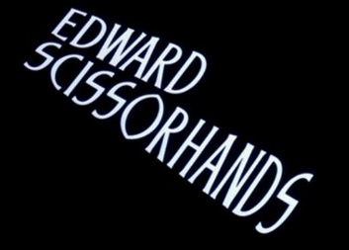
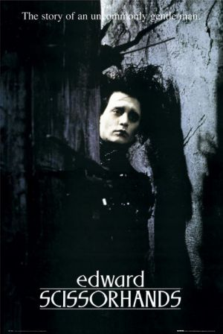
Looking for Meaning: Symbols & Motifs

Slide 2
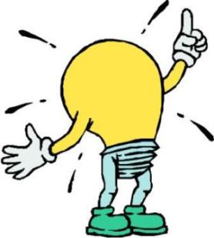
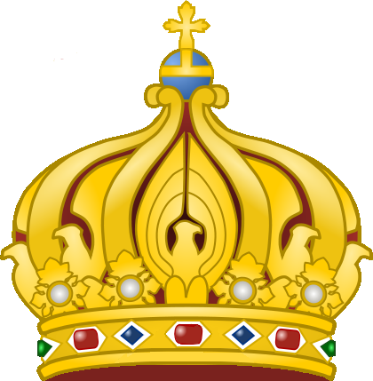
What is Symbolism?
Symbolism is the representation of a concept through symbols or underlying meanings of objects or qualities.
Examples:
A light bulb is used as a symbol for an idea.
A crown is symbolic of royalty.
Notes:
Some symbols are more literal than others (ie; the crown) and others are metaphorical (light-bulb)

Slide 3
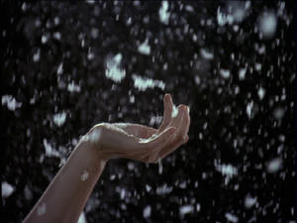
What’s a Motif?
A motif is a recurring image, theme or idea in text that often has symbolic meaning, though it doesn’t have to.
Examples:
In ‘Edward Scissorhands’, falling snow is a motif, because it is a memorable image that is repeated throughout the film. It may represent something slightly different each time it appears.
Hands are also a motif in the film.
Notes:
A MOTIF is a recurring element (i.e. structures, contrasts, or devices) that helps to
develop a major theme of a text. A motif is usually symbolic in some way, but does not
have to be. In film, a motif is typically a repeated idea, action, pattern, or image.
http://lpsaplit.files.wordpress.com/2008/11/motif-in-movies.pdf

Slide 4
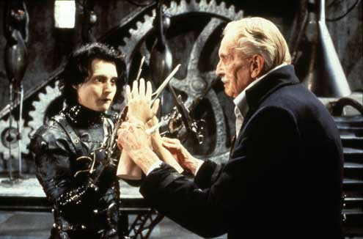
Looking for meaning
Hands are what Edward lacks. What do they signify?
Notes:
Hands are more human than scissors. They represent everything that is different and limiting about Edward.
The ability to touch and feel, show his affection for those he loves, to communicate effectively (consider gestures etc)

Slide 5
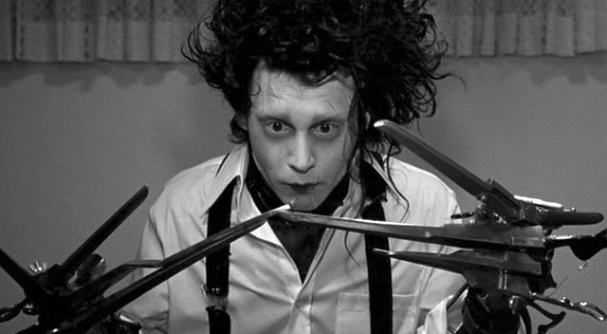
What do the scissors represent?
Notes:
Everything Edward is unable to do, and everything he can do so well, the other characters can not.
They are also the thing that gives him skill that is envied by others.
They are the things that limit him.
They symbolise violence, as they are weapons.
They prevent him from being able to touch others without hurting them

Slide 6
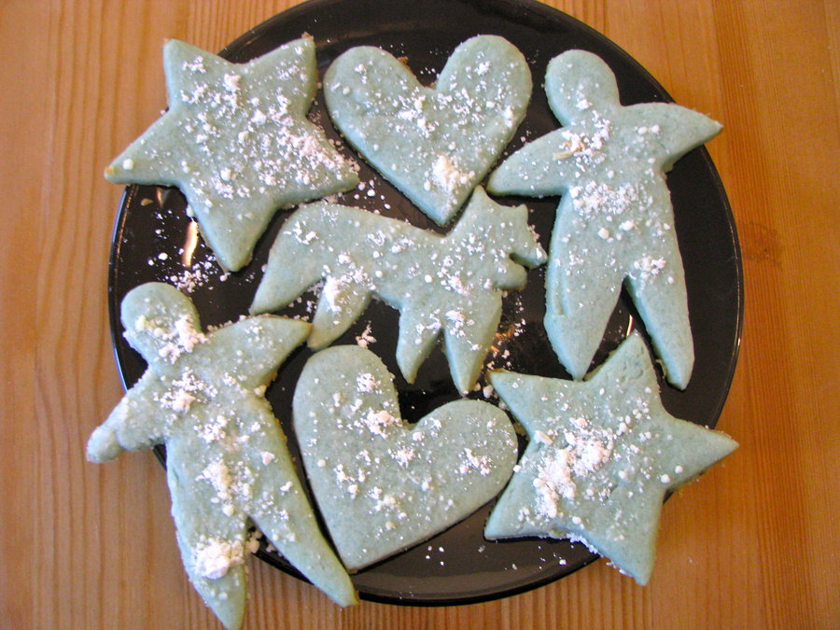
In a ‘Cookie Cutter’ World
Referring to something as ‘cookie cutter’ (ie; a “cookie cutter suburb”) means it’s all the same, cut from the same shape; characterising a lack of originality.
Notes:
http://www.phrases.org.uk/meanings/cookie-cutter.html

Slide 7
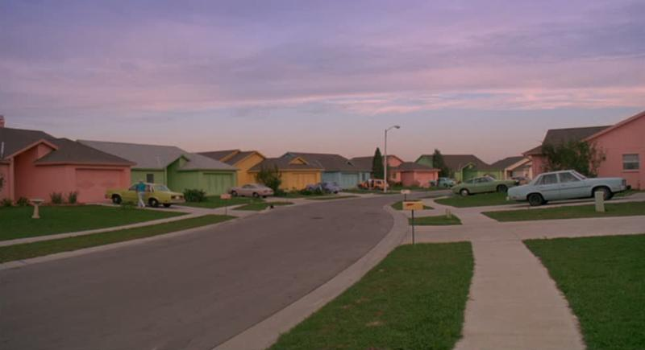
Given the meaning of ‘cookie cutter’, what is the significance of the cookies being made in the opening credits?
Notes:
All the houses are the same;
All the people are the same;
This highlights Edward’s alienation in his new home. He has not been “cut” (created) the same as others.
We naturally like a sense of uniformity and whenever the equilibrium of uniformity/conformity is jeopardised, naturally people start to react negatively.

Slide 8
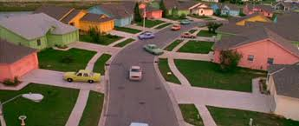
“Burton’s spectrum of pastels, rainbows and contrasts is superbly rendered boasting bright, rich and vibrant colours. Throughout the film in the ‘burbs the sky is a brilliant blue, with a rich, healthy green grass. The houses appear manufactured and alienating, all coloured with a different bright pastel colour. The houses are all the same, and the occupants of each house have a matching colour car, all of the same make. Their manicured street screams of “housing estate” and builds a picture of the so-called perfect American neighbourhood.”
Notes:
http://www.dvd.net.au/review.cgi?review_id=1617

Slide 9
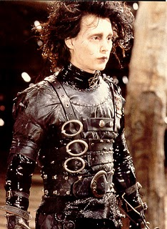
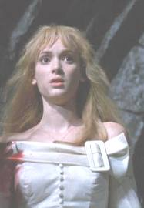
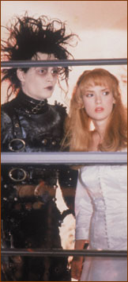
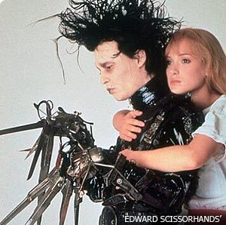
Symbolism in Costume
Notes:
Black vs White – “good vs evil”
White dress – virginal, pure.
Black leather, buckles, his hands as weapons. He’s “contained” within his costume.

Slide 10
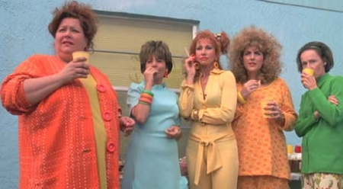
Symbolism in Costume & Colour
Notes:
Why are all the people in the neighbourhood dressed in such brightly coloured clothes?
[It’s not necessarily indicative of the time. In fact, the film is meant to be ‘timeless’.]
What do the bright colours signify?
Are they simply a contrast to Edward?

Slide 11
Colour in Costume
“The houses and scenery are not the only flashes of colour during the film, the brightly coloured, lost-’70s wardrobe from costume designer Colleen Atwood boasts bright and stunning fluorescent colours teamed with oddball/retro styles. These colours are all mastered so well and the skin tones are still natural, realistic and lifelike.”
Notes:
http://www.dvd.net.au/review.cgi?review_id=1617

Slide 12
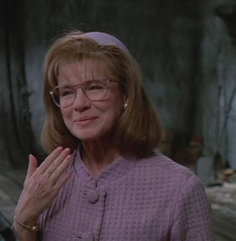
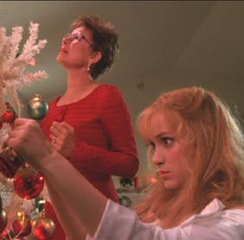
Symbolism in Costume & Colour
Notes:
Peg starts the film in lilac, neat bobbed hair, matching hat.
Edward’s impact on her is seen in the final scenes where she is in bold red, with a far edgier hair cut.

Slide 13
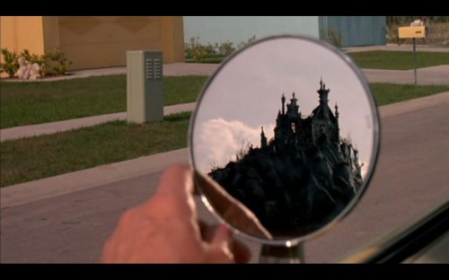
Visual Contrasts
What is being contrasted in this key image from the film? How is the contrast shown?
Notes:
How does the contrast in images relate to the themes of the text?
Alienation? Identity? Good Vs. Evil?

Slide 14
Hairstyles
Consider the contrasting hairstyles of Joyce in this image.
Edward gives many of the women very unusual, mostly asymmetrical styles.
Is this symbolic of Edward, and/or his impact on the neighbourhood?
Notes:
Asymmetrical – unbalanced
The equilibrium is jeopardised.

Slide 15
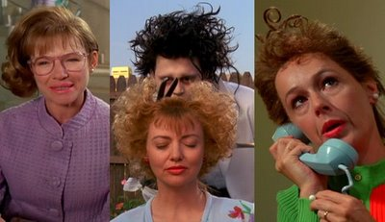
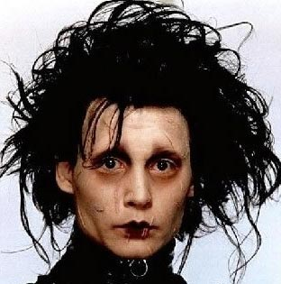
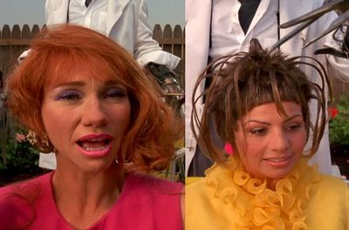
Edward is praised for his creative and unique haircuts
What do you notice about them?
What might the haircutting scenes symbolise?
Notes:
Interesting to note that this is the only way Edward can touch others without hurting them.

Slide 16
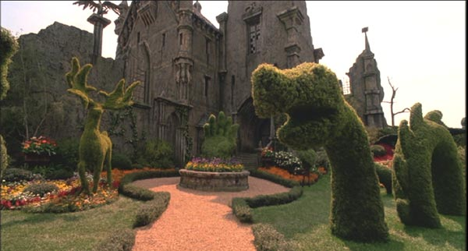
What do Edward’s creations symbolize?
Notes:
The beauty in his world;
The one thing he has control over;
‘Life’ – he has no other living things surrounding him.

Slide 17
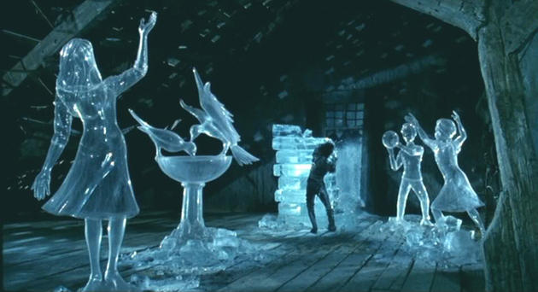
Ice Sculptures
Notes:
What is significant about the ice sculptures?
Edward replicates the world around him. He knows he can please others with his creations.

Slide 18
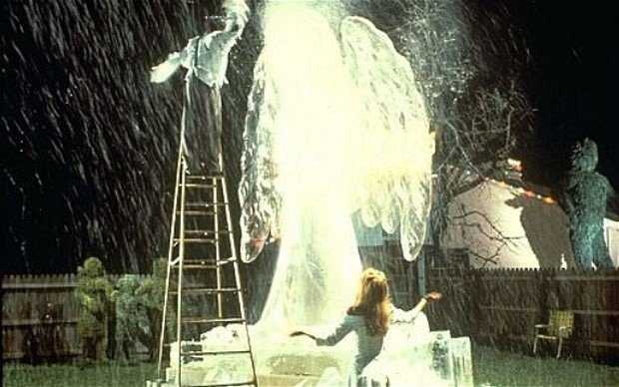
Notes:
He creates ‘snow’ which is uncommon where they live. This pleases Kim – something Edward strives to do.

Slide 19
‘Snowflakes’
Notes:
Is this Edward’s only way of safely ‘touching’ Kim?
It never snowed until Edward arrived.

Slide 20
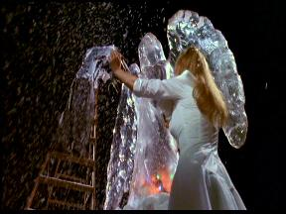
Kim dances in the falling ‘snow’ (it never snowed until Edward came along)
Notice the sculpture is of an angel, and Kim is in a white dress. What parallels can be drawn between the two?
Notes:
Kim is Edward’s ‘angel’, shows him love and affection, accepts him.
Beauty fades, ice melts, but Kim’s affection for Edward remains,

Slide 21
Symbolism of colour
“Colours are used to a large extent to extend the character of the characters, especially with Kim. During the ‘ice dance’ sequence she can be seen in a white dress, symbolising innocence and purity, as this is just after the loss of a mean-spirited person in her life. Her room is filled with rich yellow and golden tones adding a happy and carefree feel to her character. With Edward, his black leather outfit contrasts sharply to his stark white face. These subtle yet meaningful symbols occur throughout the film and add so much to the story.”

Slide 22
Notice how colours make a character an ‘alien’ in a different ‘world’

Slide 23
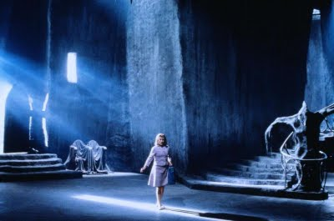
Peg as an ‘alien’ in Edward’s world

