Slide 1
Slave Narratives Day 3
Engelbert 2016

Slide 2
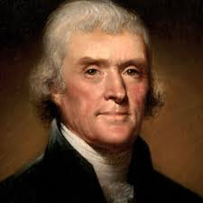
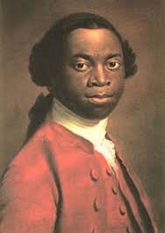
Unit Essential Questions:
How do writers convey the essence of freedom?
How has the concept of freedom evolved over time?

Slide 3
FLT
Given a collection of Slave Narratives,
We will analyze the themes and rhetorical devices of these autobiographical accounts
By charting the texts and sharing our analyses with others.
HOW WILL I KNOW I KNOW IT?
I can describe the power of literary devices to influence tone and demonstrate pathos in a primary source.

Slide 4
Warm-Up:

Slide 5
How to Read a Slave Narrative MEMORY RECALL: What’s the difference between a primary source and a secondary source? List 3 examples of primary sources.

Slide 6
Primary sources : records that have survived from the past, such as letters, photographs, articles of clothing. Secondary sources: accounts of the past created by people writing about events sometime after they happened. Examples include: Original documents: autobiographies, diaries, e-mail, interviews, letters, reports, published materials (newspapers, magazine and journal articles, books), visual and audio records, news film footage, cartoons and advertisements, photographs, research data (field notes, data sets, scientific experiments), speeches, manuscripts, journals, memos, memoirs, public opinion polls, government records (wills, deeds, court cases, official records, census records, licenses) Creative works: art, drama, films, music, novels, poetry Relics or artifacts: buildings, clothing, DNA, furniture, jewelry, pottery

Slide 7
What questions might you ask yourself to determine the validity of a primary source?

Slide 8
Consider the author, the title of the work, the summary, where it is, and the timeliness of the entry. You may also want to look at the keywords to see what other categories the work falls into. Evaluate this information to see if it is relevant and valid for your research. -Who is the author? Is he/she a reliable source? (ethos) -When was it written? Why? -Is the publication a respectable source? (.gov, .org) -What is the tone of the document? (satirical?) -What is the document’s purpose? -When and why was the document created? -Who is the intended audience? -Does the content agree with what you know or have learned about the issue?

Slide 9
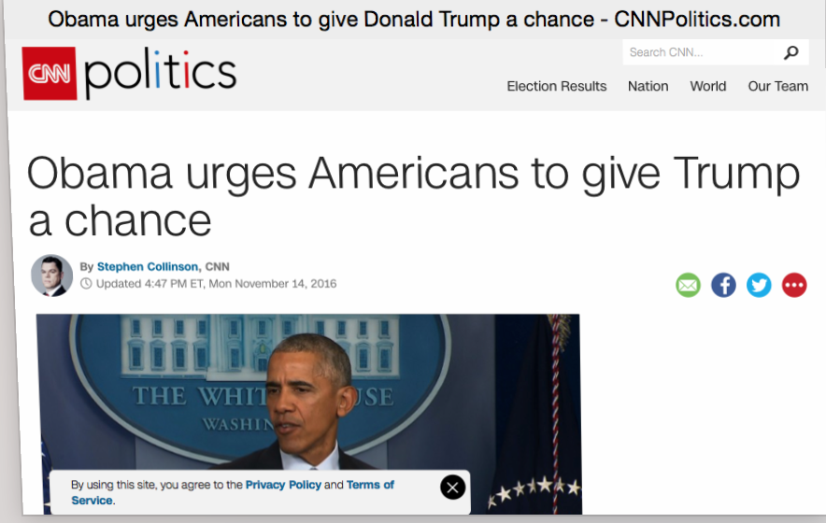
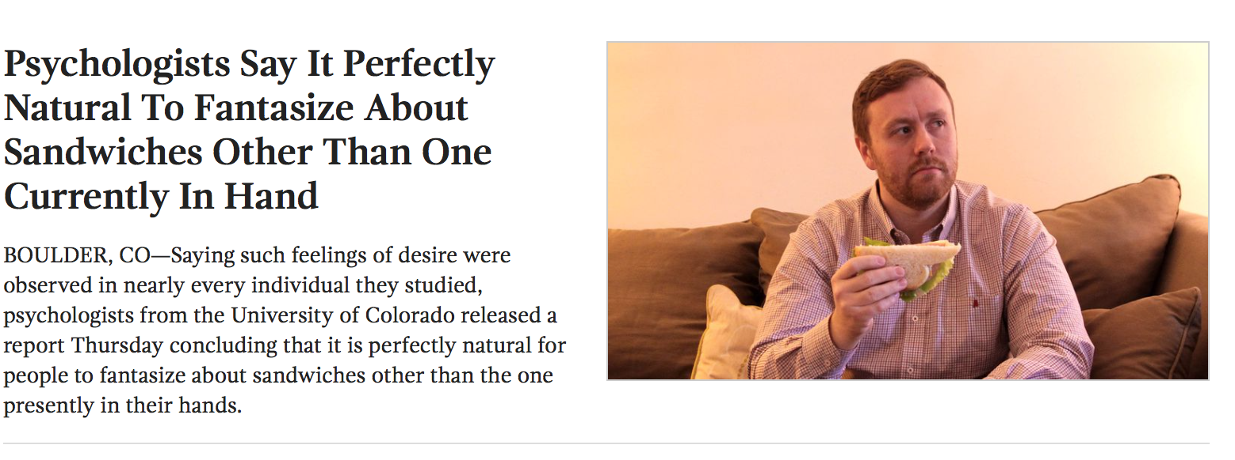
EXAMPLES
The Onion

Slide 10
-Secondary sources provide interpretation, explanation, analysis, description or restatement of a primary source. -Also, some secondary sources offer an argument or point of view in an effort to persuade. These sources are one or more steps removed from the event. -Secondary sources may have pictures, quotes or graphics of primary sources in them. -Some types of secondary sources include: Publications: textbooks, magazine articles, histories, criticisms, commentaries, encyclopedias.

Slide 11
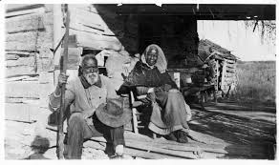
What is a Slave Narrative?
A slave narrative is an account of the life of a fugitive or former slave, either written or orally related by the slave himself or herself. Slave narratives comprise one of the most influential traditions in American literature, shaping the form and themes of some of the most celebrated and controversial writing, in both autobiography and fiction, in the history of the United States. From 1760 to the end of the Civil War in the United States, approximately one hundred autobiographies of fugitive or former slaves appeared. After slavery was abolished in North America in 1865, at least fifty former slaves wrote or dictated book-length accounts of their lives. During the Depression of the 1930s, the Federal Writers Project gathered oral personal histories from 2,500 former slaves, whose testimony eventually filled eighteen volumes.

Slide 12
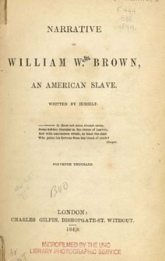
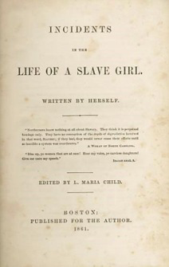
What does the title page of a slave narrative tell us?
Notes:
The title page of a slave narrative bears significant clues as to the authorship of the narrative itself. Subtitles often convey the role that the subject named in the narrative’s title actually played in the production of the narrative. The narratives of Equiano, Grimes, Douglass, Wells Brown, and Bibb, for instance, all bear the subtitle Written by Himself. Though the title page of Incidents in the Life of a Slave Girl does not name the “Slave Girl” whose life story follows, the subtitle of the book states that it was Written by Herself. Narratives that identify the subject and author of the text as one and the same represent, in the eyes of many scholars, the most authoritative texts in the tradition. Ask students why it would be important for white readers of the mid-nineteenth century to see the Written by Himself or Herself subtitle in these narratives? Why is authorship of one’s own story so important? Students should understand that identifying a slave narrator as literate and capable of independent literary expression was a powerful way to combat a key proslavery myth, which held that slaves were unself-conscious and incapable of mastering the arts of literacy. Students should remember that in mid-nineteenth-century America, where many whites had had little or no schooling, literacy was a marker of social prestige and economic power.

Slide 13
Partner Analysis Questions:
During the warm-up, I gave you and your desk partner an excerpt of a Slave Narrative from either Harriet Jacobs or Frederick Douglass. Answer the questions on the back of your notetaking guide based upon your Narrative selection. The questions are based on Bloom’s Taxonomy
And go from easiest to hardest.
You have 20 minutes to finish as many as you can.

Slide 14
2 MIN SHARE OUT:

Slide 15
QUAD ACTIVITY
1.) Turn your desks in to a four-plex.
2.) Empty the contents of your envelope. Each person should receive
one slave narrative (different colored paper that is 8.5X11.5) and one
Mini-narrative (smaller sheets).
3.) For the first three minutes, read and study the full size narrative.
There’s a QR code on the outside of the envelope (or you can type
In the YouTube address) for an AV recording of the piece. Make sure
You set the video to the correct time.
4.) After the five minutes on the timer expire, fill out the jigsaw column
For your narrative. Then in timed increments, share your story with
Your team members, until all four narratives are discussed and recorded.

Slide 16
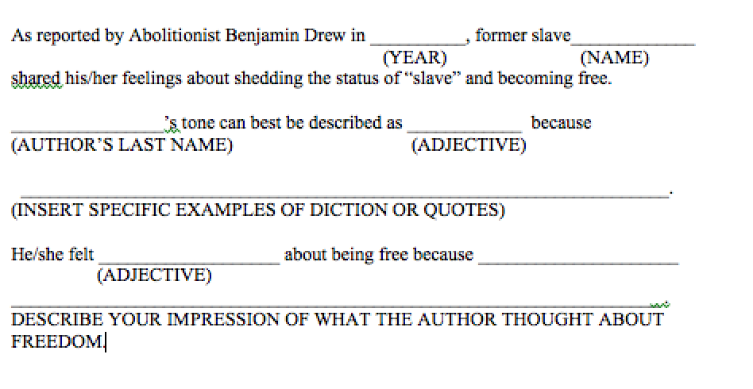
EXIT TICKET
USE THE SENTENCE FRAME BELOW IN RELATION TO YOUR SELECTED EMANICIPATION MINI-NARRATIVE.

