Slide 1
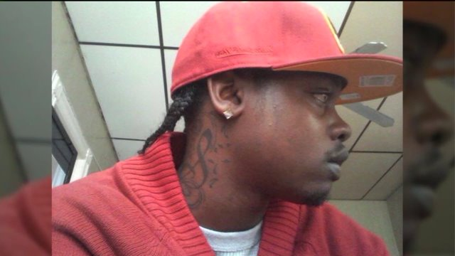
Akai Gurley
November 20, 2014
STUDENT NAMES

Slide 2
On the day of:
Officer Peter Liang and his partner, Shaun Landau, enter a stairwell from the 8th floor with Liang holding a gun in his left hand, and a flashlight in his right.
Akai Gurley and girlfriend, Melissa Butler (both unarmed), enter one floor below the officers.
Liang fires a shot into the “pitch black” darkness; the bullet ricochets and strikes Gurley in his chest.
The officers retreat to the 8th floor, while Gurley runs down two flights.
Officer Peter Liang argues with his partner and waits a full 4 minutes before he reports the shooting.
The cops spot Gurley on the fifth-floor landing and Liang “just stood there,” as Butler attempts to administer CPR.

Slide 3
https://www.youtube.com/watch?v=dQyN4hYyX2A

Slide 4
The Aftermath
In conclusion
THE OUTCOME: Liang pleaded not guilty to second-degree manslaughter, second-degree assault and criminally negligent homicide, all felonies; and a misdemeanor count of reckless endangerment and two counts of official misconduct. He is currently serving five years of house arrest and 800 hrs of community service.
FOR THE FUTURE: In for something like this to not happen again, we believe patrolling officers shouldn’t have their gun out and be ready to fire when there is no danger present. Also, the officer who discharged the weapon had less than 2 years on the force when this happened. We believe officers need a min. of two years active/shadow duty before being allowed to use a gun.

Slide 5
SOURCES:
CBSNewYork. “Sources Tell CBS2 Grand Jury Will Indict Cop In Akai Gurley Shooting.” YouTube,
YouTube, 10 Feb. 2015, www.youtube.com/watch?v=dQyN4hYyX2A
Carrega-woodby, Christina, et al. “Ex-NYPD Cop Peter Liang Spared Jail in Death of Akai Gurley.” NY
Daily News, NEW YORK DAILY NEWS, 19 Apr. 2016, www.nydailynews.com/new-york
/brooklyn/ex-nypd-peter-liang-spared-jail-death-akai-gurley-article-1.2607310.

