Slide 1
American Rationalism (1750-1800)

Slide 2
UNIT 2: A GROWING NATION
Essential Question:
How do writers convey the essence of freedom? How has the concept of freedom evolved over time?

Slide 3
WHAT NOW?
-Puritan New England lasted from about 1630-1720. There were three things that needed to happen for that society to exist:
1) the colonies thrived on and required religious unity
2) a proto-democratic political system was necessary to protect the unique society created in America;
3) the colonists devoted themselves to evading direct rule from England in order to maintain that political system. For as long as these three characteristics were unchallenged, Puritan New England existed.
The Colonists battled with England over religion, land, and government policies for several years. As a result, many non-Puritans began colonizing there, and politics became the new religion.
Notes:
How long was that? Not very long. The aftermath of King Philip’s War (1675-6) brought political discord between the Puritan colonies, which brought on direct rule from England, first in the form of the Dominion of New England (1686-9), during which time the Puritan colonies of Massachusetts, Vermont, New Hampshire, Connecticut, and Rhode Island were restructured into one mega-colony (along with New York and East and West Jersey). It’s important that during the Dominion the Puritans were enraged not just by the promotion of Anglicanism over Congregationalism but also by the destruction of the Puritan legal and political system: legislatures were no longer popularly elected, land titles were revoked, and a royal court with no jury was set up in Boston to enforce the Navigation Acts.The Dominion was overthrown after the death of King James II, but English direct rule did not end. The Puritans who had overthrown the Dominion immediately pledged their loyalty to the new king and queen, William and Mary, and William opened the Puritan colonies to outsiders. Non-Puritans began settling in New England in large numbers, and their religious practices were protected. By 1691, when the Massachusetts Bay Colony’s charter was overthrown and it became a royal colony with a royally appointed governer, true Congregationalism was rapidly becoming a blast from the past. Its dominance was certainly at an end, as it became simply one religion amongst many others.Of course, it took decades to completely unseat the old religious ways. But an important shift was occurring after 1689: all of the fervor originally associated primarily with religion in Puritan New England was being gradually but steadily transferred to politics. Note that the Dominion and the charter revocation dealt a fatal blow to pure Congregational practice but strengthened the old Puritan political dogma. What the people of New England held on to was proto-democracy: a popularly elected legislature, juries made up of local citizens, and the right of towns to hold their political town meetings. As the old religion which had originally demanded these political protections faded away, the politics themselves became a religion for New Englanders.

Slide 4
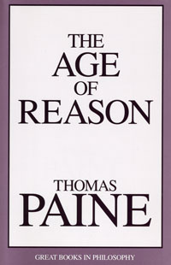
Rationalism
Rationalism – the belief that human beings can arrive at truth by using reason, rather than by relying on the authority of the past, on religious faith, or intuition.
REASON!

Slide 5
A reaction against Puritanism
By the end of the 17th century, reason began to present a challenge to the unshakable faith of the Puritans.
VS.

Slide 6
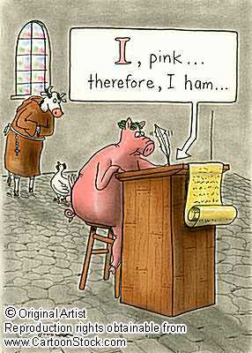
Descartes’ "I think, therefore I am,"
replaces Anselm’s
"I believe so that I might understand.”
REASON and LOGIC become more important than FAITH and RELIGION

Slide 7
Thomas Jefferson’s Bible
Jefferson changed parts of the Bible to create a new version—particularly the parts that tell the life of Jesus
In it, he removed all references to supernatural aspects: miracles, angels, and the divinity and resurrection of Jesus.
He wanted a Bible that showed Jesus as a great moral teacher, but nothing more.

Slide 8
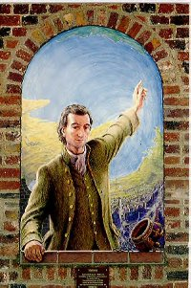
Often called “The Age of Reason” or
“The Enlightenment”
Less focus on hell or life after death – more concern with creating a better life on earth. …and yet…
I believe in one God, and no more; and I hope for happiness beyond this life.
THOMAS PAINE
THE AGE OF REASON

Slide 9
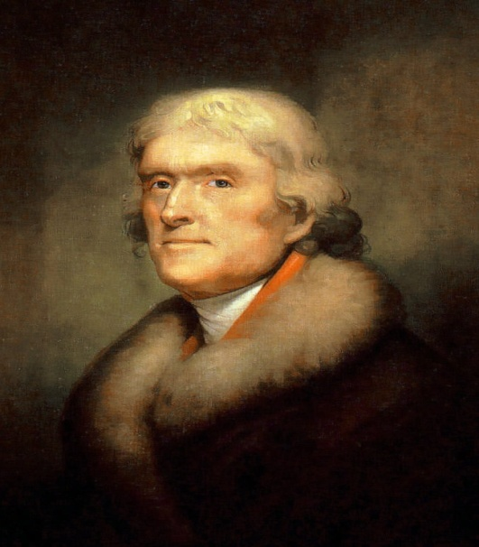
God’s Gift to Humanity was…
Reason – the ability to think in an ordered, logical manner enabled people to discover both scientific and spiritual truth.
“Reason and free inquiry…are the natural enemies of error, and of error only.”
Thomas Jefferson,
Notes on the State of Virginia

Slide 10
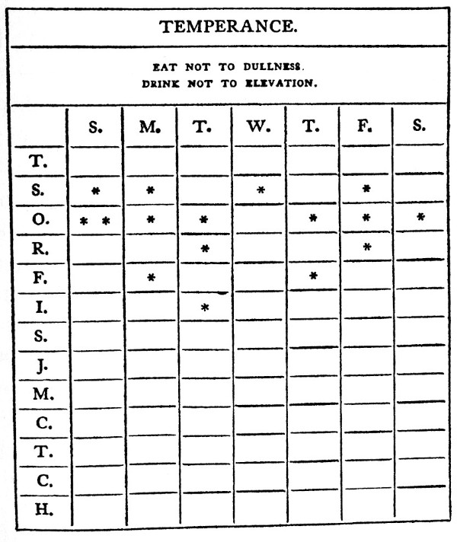
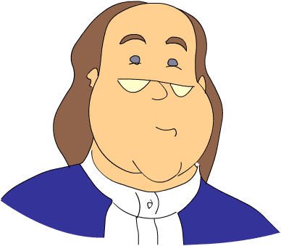
Unlike the Puritans…
Rationalists believed people were able to perfect themselves—through good works and self effort
I will not drink
5 Dr. Pepper
Big Gulps today!

Slide 11
A scientific explanation for God’s existence
Sir Isaac Newton compared God to a clockmaker.
the Great Machine must have a Mechanic or a Supreme Architect.

Slide 12
Deism
God had made it possible for all people at all times to discover natural laws through their God-given power of reason.

Slide 13
Deists believed
The universe was orderly and good.
Through the use of reason, every human being was perfectible.
God’s objective was the happiness of his creatures.
There were punishments and rewards after this life
Their faith was a philosophy and a guide for an ethical way of living rather than an organized religious institution

Slide 14
Deists did NOT believe
In superstition
In the holy trinity
In a literal interpretation of the bible
That worship required attending a service (one could worship privately)
John Locke said “Believe in Jesus and lead a moral life.”

Slide 15
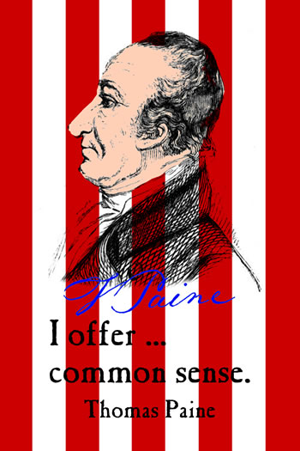
Rationalism Literature:
- mostly devoted to politics, philosophy, ethics, and science
Persuasive essays and pamphlets
Songs
Speeches
Poems
Documents such as The Declaration of Independence--which bases its arguments on rationalist assumptions about the relations between people, God, and natural law.

Slide 16
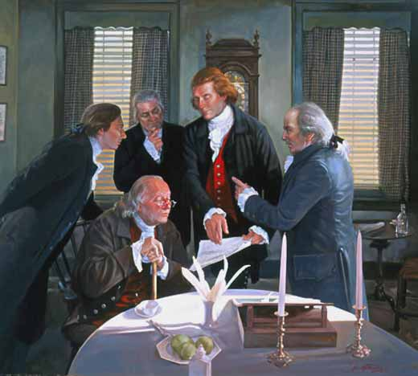
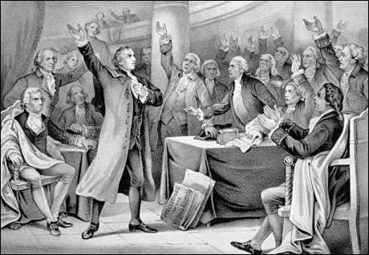
Reason thrived on…
Freedom of speech
Freedom from arbitrary rules
Freedom to experiment
Freedom to question existing laws and institutions

Slide 17
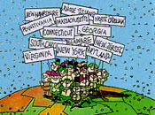
The Age of Reason in the United States differed from previous Rationalism movements in Europe namely because American citizens could test new ideas as they created a new society.

Slide 18
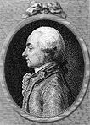
Rationalism was about HOPE
“What then is…this new man? He is an American, who, leaving behind him all his ancient prejudices and manners, receives new ones from the new mode of life he has embraced, the new government he obeys, and the new rank he holds…[In America] individuals of all nations are melted into a new race of men, whose labors…will one day cause great changes in the world.”
Michel-Guillaume Jean de Crevecoeur,
Letters from an American Farmer

Slide 19
TERMS TO KNOW:
Now, open up your textbooks to page 96-97 and copy down the terms and definitions for the types of speeches, persuasive techniques, and rhetorical devices.

