Slide 1
Unit 2: Gentrification and Identity
Engelbert English 11 AMA

Slide 2
Warm-up #6
When you hear the word “gentrification, what comes to mind? Does it have a positive or negative connotation, or both? Explain your answer.

Slide 3
I most enjoyed the moment when the HUGE turtle swam right past me. I wouldn’t have believed that turtles could ever get that big if I hadn’t seen it for myself!

Slide 4
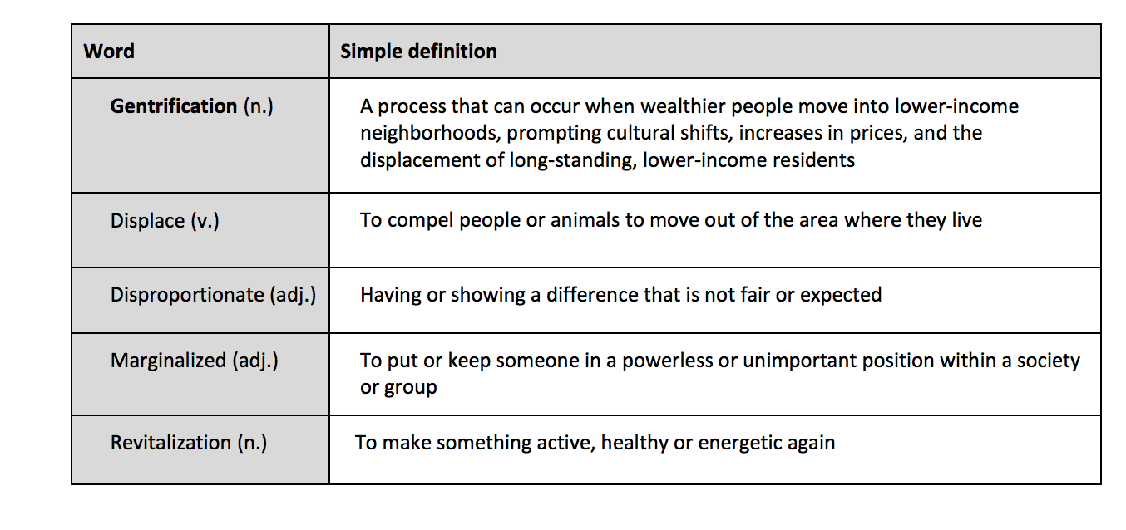

Slide 5
WATCH THIS!
https://www.youtube.com/watch?time_continue=146&v=5nyDbHi1YQE
FIRST WATCH: Get an idea of both sides of the issue.
SECOND WATCH: Make a PRO/CON list in your notebook, and record both viewpoints expressed in the video.

Slide 6
After the video and T-Chart
What are ways communities have responded to gentrification?
What are legislative ways to ease the problems of gentrification?

Slide 7
After reading the article, (See website link) please answer the following questions in your notebook. You must use complete sentences and restate the questions.
What do you think is the most positive aspect of gentrification?
What is the most negative? What happens to established residents in communities that are gentrified? Cite at least two specific examples.
Is gentrification primarily a positive or negative force? Explain your answer in detail citing specific examples.
What role does race and class play in gentrification?
What is one thing you would change, if anything, about gentrification to make it a more a positive force in communities?

