Slide 1
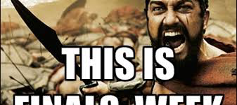
2017 English 11 Final SEMESTER ONE
Engelbert 11 AMA and CP 2016

Slide 2
WHAT WILL YOU FINAL BE?
90 questions worth two points each. The test value will be doubled, so the total final is worth 150 points. HOWEVER, I HAVE BUILT IN A 15 QUESTION/30 POINT HANDICAP FOR YOU!
If you are earning an “A” in the class, you don’t have to take the test, but you must attend the class period.
-Multiple Choice Questions
-Matching questions
-Chronological order questions

Slide 3
What best describes the relationship between place and literature?
A colonists feared nature while Native Americans paid respect to nature
B many native American myths include characters and settings reflecting specific geographic regions of the US
C both A and B
D neither A nor B

Slide 4
What best describes the relationship between place and literature?
A colonists feared nature while Native Americans paid respect to nature
B many native American myths include characters and settings reflecting specific geographic regions of the US
C both A and B
D neither A nor B

Slide 5
WARM-UP #2
1.) What themes set American literature apart from other early literature?
2.) How did the literature of the European colonists differ from that of the Native Americans?
3.) Describe the relationship between society and media by describing the symbiosis exemplified by one movie from the 21st century.

Slide 6
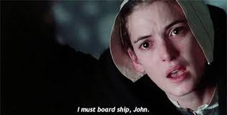
SEMESTER ONE: The isms
LET’S REVIEW!

Slide 7
What is the purpose of mythology?
to explain the unknown
to entertain the masses
to accurately record history
to give people something to believe in

Slide 8
What is the purpose of mythology?
to explain the unknown
to entertain the masses
to accurately record history
to give people something to believe in

Slide 9
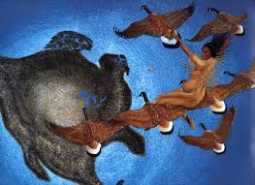
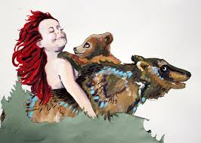
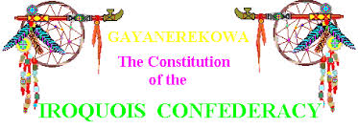
REMEMBER THESE ORAL MYTHS?
The Earth on A Turtle’s Back | When Grizzlies Walked Upright | Iroquois Constitution
-role of nature -characters -myth tropes | -role of nature -characters -myth tropes | -role of nature -characters -myth tropes
Let’s take a moment and review the plot and morals in each story.

Slide 18
Literary Consequences of 1492
Printed documents lushly describing the “new world,” and offering propaganda to stir Europeans’ individual imaginations and national ambition, emerged immediately after Columbus’s first voyage. The printing press and the European expansion into America were reciprocal parts of a single engine.
The vast majority of early American writings were produced by Europeans rather than the Native peoples of the Americas (who tended to value orality and memory over mechanical means of recording texts) with some important exceptions. Aztec written traditions, North American shellwork beads and painted animal hides, teepees, and shields, and other visual records were used in subtle and sophisticated ways. Some Natives borrowed the Roman alphabet introduced by the Spanish to record testimony in their own language.
Many European texts of the period record were communications between the colonists in the Americas and their governments at home in Europe. They were “briefs” meant to inform or influence policy decisions made at a distance or to justify actions taken.
In practice, there was often a wide gap between official colonial policies adopted in European capitals and the actions taken by colonists. The great distance separating the hemispheres made the coordination of intention and performance extremely difficult.
Some early American writing by Europeans can be characterized as “literature of witness,” often produced to critique—either subtly or bluntly—the bloodiness and corruption of the colonial project.

Slide 19
REVIEW
1.) When a piece of literature is labeled “Literature of Witness,” what does this mean?
2.) Who replaced the native American slave labor in the New World and when?

Slide 20
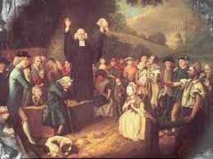
“Sinners in the Hands of An Angry God”
-Name 3 comparisions
-tone and purpose
-Puritan beliefs
-literary devices
-LOOK AT YOUR NOTEBOOK FOR THIS ONE!!!!

Slide 21
REVIEW
1.) What is the difference between mood and tone? How did the written tone of Edward’s words differ from how he actually presented his sermon, “Sinners in the Hands of an Angry God”?
2.) Why did the Puritans separate from the Church of England?

Slide 22
LIT TERMS:
HYPERBOLE:
ANAPHORA:
ETHOS:
APPOSITIVE:
ALLUSION:
ANACHRONISM:
EUPHEMISM:

Slide 23
LIT TERMS:
HYPERBOLE: an exaggeration
I’m so hungry, I could eat a horse!
ANAPHORA: repetition in the beginning of a phrase
I will go. I will fight. I will fun.
ETHOS: when an expert of authority give you info
The preacher is the representative authority for God
APPOSITIVE: a title or description after a noun that gives you more information
Ms Engelbert, my teacher, is weird.
ALLUSION: A reference from literature to something else
She found her holy grail in musical theater.
ANACHRONISM: Taking something from the past and putting it where it doesn’t belong.
They didn’t have helicopters in the American revolution!
EUPHEMISM: Making something sound nicer than what it really is
A stay at home mom might be called a domestic engineer

Slide 24
Pilgrim and Puritan
The English settlers who established Plymouth Plantation in 1620 (later known as the Pilgrims) and the English Puritans who established a settlement in Boston in 1630 shared a wish to purify Christian belief and practice.
The Pilgrims advocated separating from the established Church of England, while the Puritans hoped to purify it from within. By 1691, the Pilgrims had been subsumed by the Massachusetts Bay colony, and the two groups merged.
Both the Pilgrims and the Puritan settlements were commercial enterprises as well as religious ones. They were backed by investors in England and included secular settlers who came to America for economic opportunity rather than out of religious conviction.
Puritans and Pilgrims accepted John Calvin’s doctrine of election, holding that God had chosen, or “elected” before their birth those he would save and those he would damn eternally.
While the doctrine of election can seem harsh, there was also joy in Puritan life, often as a result of meditations on Christ’s redeeming power.
Puritan churches administered the sacrament of communion only to those who had become church members by standing before their minister and elders and giving an account of their conversion. This process contributed to the Puritans’ sense of being a special, or chosen, few—a concept John Winthrop gave voice to when he exhorted the immigrants to the Bay Colony to live as a shining example to all other peoples as “a city upon a hill.”

Slide 25
Writing in Tongues
An enormous variety of languages were spoken and written in seventeenth-century North American settlements, including, among others, French, Dutch, Walloon, Spanish, Scandinavian, Portuguese, Gaelic, German, African languages, and, of course, Native American languages.
Eventually, political events would make English a useful lingua franca for the colonies at large and, in time, the literary medium of choice. It is important to remember, however, the initial linguistic and cultural diversity of the colonial North American world.

Slide 26
LITERATURE TIMELINE…
PURITANISM
RATIONALISM
ROMANTICISM
TRANSCENDENTALISM
REALISM
NATURALISM

Slide 27
Puritanism
The Puritan society placed God at the center point of society, and their literature works which were primary diaries and histories expressed God as the central theme. The Puritan writing is very strict and simple.
Bible provides a model for Puritan writing.
Biblical events related with their own lives.
Used writing to find God in their lives

Slide 28
Examples of Puritanism
Sermons, diaries, personal narratives
Jonathan Edwards’ “Sinners in the Hands of an Angry God”
Edward Taylor’s “Huswifery”
Though not written during Puritan times, The Crucible & The Scarlet Letter depict life during the time when Puritan theocracy prevailed.

Slide 29
What is Puritan predestination?
A. God had already chosen who would go to heaven and who would go to hell
B God had already chosen what job and destiny you would have
C God had already decided who you would marry
D Man chooses his own destiny

Slide 30
What is Puritan predestination?
A. God had already chosen who would go to heaven and who would go to hell
B God had already chosen what job and destiny you would have
C God had already decided who you would marry
D Man chooses his own destiny

Slide 31
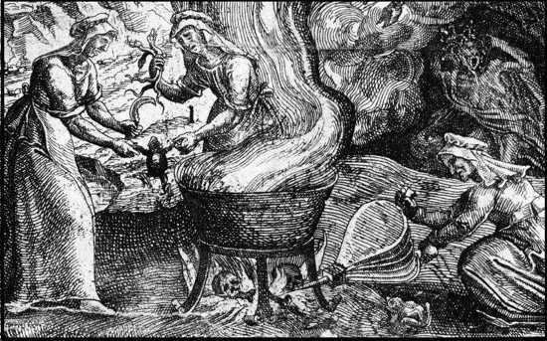
WITCH TESTS!

Slide 32
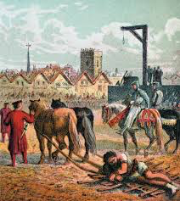
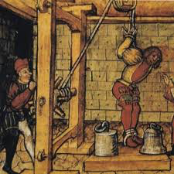
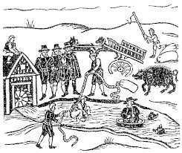
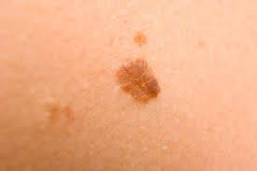
What are these?
How many people were killed during the historic Salem witch trials?

Slide 33
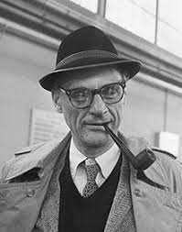
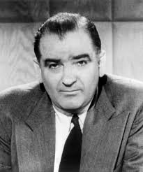
What situation was Arthur Miller contesting when he wrote The Crucible?

Slide 34
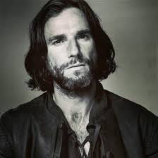
Why doesn’t John Proctor like to go to church?
because his house is far away
he doesn’t believe in God
he doesn’t like the way Parris preaches
he doesn’t want to see Abigail there

Slide 35
Why doesn’t John Proctor like to go to church?
because his house is far away
he doesn’t believe in God
he doesn’t like the way Parris preaches
he doesn’t want to see Abigail there

Slide 36
QUESTION?
Given circumstances are anything that happen before the opening of a play. What pivotal event sets everything in motion?
A Abigail has an affair with John Proctor
B Parris brings Tituba to America
C The girls dance in the woods and get caught; Betty freaks
D Rev. Hale comes to town

Slide 37
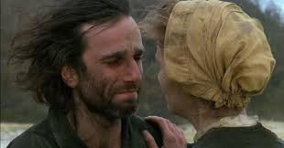
CONFLICTS:
Man vs Man
Man vs Animal
Man vs Himself
Man vs Circumstance
Man vs Society
Can you think of an example from the Crucible that suits each of these types of conflict?

Slide 38
QUESTION
Which is NOT a theme of The Crucible?
love conquers all
mass hysteria
doing anything to save your reputation
religious hypocrisy

Slide 39
QUESTION
Which is NOT a theme of The Crucible?
love conquers all
mass hysteria
doing anything to save your reputation
religious hypocrisy

Slide 40
QUESTION?
Given circumstances are anything that happen before the opening of a play. What pivotal event sets everything in motion?
A Abigail has an affair with John Proctor
B Parris brings Tituba to America
C The girls dance in the woods and get caught; Betty freaks
D Rev. Hale comes to town

Slide 41
WORRIED?
DEFINITELY TAKE THE TIME TO REVIEW THE CRUCIBLE PPT ON THE WEBSITE!

Slide 42
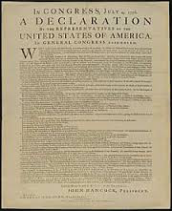
RATIONALISM!!!!!
Dear England,
We’re breaking up. It’s over. I hate you.
Love,
America

Slide 46
What was expressed in these other speeches?
SEE TEXTBOOK AND NOTEBOOK
*Patrick Henry’s speech at the Virgina Convention
*Jefferson’s Speech At Convention
“American Crisis”

Slide 47
RHETORICAL APPEALS
ETHOS: When in the Course of human events, it becomes necessary for one people to dissolve the political bands which have connected them with another, and to assume among the powers of the earth, the separate and equal station to which the Laws of Nature and of Nature's God entitle them, a decent respect to the opinions of mankind requires that they should declare the causes which impel them to the separation.
LOGOS: We hold these truths to be self-evident, that all men are created equal, that they are endowed by their Creator with certain unalienable Rights, that among these are Life, Liberty and the pursuit of Happiness.-
PATHOS: He has plundered our seas, ravaged our Coasts, burnt our towns, and destroyed the lives of our people.

Slide 48
SLAVERY
What two subjects were predominantly expressed in slave spirituals?
A Christian values and the hardships of slavery
B Cultural myths and familial stories
C Christian values and family heritage
D The hardships of slavery and cultural traditions

Slide 49
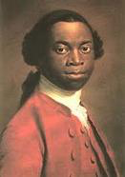
Summarize “The Interesting Life of Oludah Equiano”
-How did he become educated?
-What examples of death did he witness?
-When did he find hope?

Slide 50
SLAVERY
What two subjects were predominantly expressed in slave spirituals?
A Christian values and the hardships of slavery
B Cultural myths and familial stories
C Christian values and family heritage
D The hardships of slavery and cultural traditions

Slide 51
REMEMBER THESE TALES?
Jigsaw of four stories

Slide 52
QUICK REVIEW SLIDE:
PURITANISM: strict, ruled by God, predestination
RATIONALISM: decisions should be ruled by logic and reason; govt. documents
ROMANTICISM: emphasized inspiration, the individual, and emotion

Slide 53
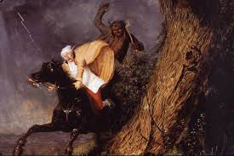
THE DEVIL AND TOM WALKER
What was this story about?

Slide 54
How is the Washington Irving’s description of the setting in “The Devil and Tom Walker” reflective of the relationship between Walker and his wife? Pick the quote that best describes this relationship.
A. “They lived in a forlorn looking house that stood alone, and had an air of starvation”
B. “The swamp was thickly grown with great gloomy pines and hemlocks”
C. “…one of the great trees , fair and flourishing without, but rotten at the core…”
D. “they were so miserly, then even conspired to cheat each other”

Slide 55
How is the Washington Irving’s description of the setting in “The Devil and Tom Walker” reflective of the relationship between Walker and his wife? Pick the quote that best describes this relationship.
A. “They lived in a forlorn looking house that stood alone, and had an air of starvation”
B. “The swamp was thickly grown with great gloomy pines and hemlocks”
C. “…one of the great trees , fair and flourishing without, but rotten at the core…”
D. “they were so miserly, then even conspired to cheat each other”

Slide 56
How does this quote show foreshadowing?
""Deacon Peabody be damned," said the stranger, "as I flatter myself he will be, if he does not look more to his own sins and less to those of his neighbors.”

Slide 61
Poe’s story concerns itself with the duality of man in terms of his potential for good/evil and his soul/body . If this is true, then who is who?
A Roderick is an evil soul and Madeline is the positive body.
B Madeline is an evil soul and Roderick is the positive body.
C Roderick is the evil body and Madeline is the positive soul..

Slide 62
QUESTION?
At the end of story, the house gets swallowed up by the mist and falls into the lake when the zigzag cracks falters. This is an example of:
hyperbole
pathetic fallacy
extended metaphor

Slide 63
QUESTION
While passing his last days with the narrator, Roderick immerses himself in the arts: music, books, and paintings. What is perhaps behind this motivation?
with his family dying off, he wants to leave behind work that will capture his immortality
he believes in the soothing and healing power of the arts
engaging in the arts helps him escape his own acute anxiety and fear

Slide 64
DIRECT VS. INDIRECT CHARACTERIZATION
“Roderick Usher had been one of my boon companions in boyhood”
DIRECT
“Lips somewhat thin and very pallid; hair of a weblike softness”
DIRECT
When Roderick takes his chair and positions it facing the door while mumbling to himself
INDIRECT

Slide 65
THE RAVEN

