Slide 1
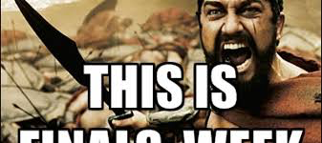
2017 English 11 Final SEMESTER ONE
Engelbert 11 AMA and CP 2016

Slide 2
WHAT WILL YOU FINAL BE?
PART ONE: 40 multiple choice questions worth 2 points each.
PART TWO: Read and article, write 2 short responses, and correct 10 grammar errors.
If you are earning an “A” in the class, you don’t have to take the test, but you must attend the class period.
-Multiple Choice Questions
-Matching questions
-Chronological order questions
WORTH 100 POINTS!

Slide 3
What best describes the relationship between place and literature?
A colonists feared nature while Native Americans paid respect to nature
B many native American myths include characters and settings reflecting specific geographic regions of the US
C both A and B
D neither A nor B

Slide 4
What best describes the relationship between place and literature?
A colonists feared nature while Native Americans paid respect to nature
B many native American myths include characters and settings reflecting specific geographic regions of the US
C both A and B
D neither A nor B

Slide 5
Think on this…
1.) What themes set American literature apart from other early literature?
2.) How did the literature of the European colonists differ from that of the Native Americans?

Slide 6
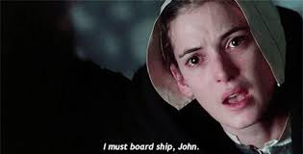
SEMESTER ONE: The isms
LET’S REVIEW!

Slide 7
What is the purpose of mythology?
to explain the unknown
to entertain the masses
to accurately record history
to give people something to believe in

Slide 8
What is the purpose of mythology?
to explain the unknown
to entertain the masses
to accurately record history
to give people something to believe in

Slide 9
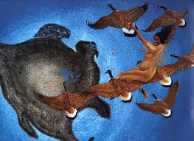
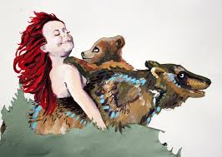
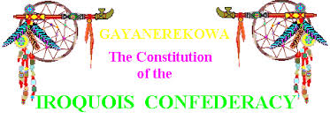
REMEMBER THESE ORAL MYTHS?
The Earth on A Turtle’s Back | When Grizzlies Walked Upright | Iroquois Constitution
-role of nature -characters -myth tropes | -role of nature -characters -myth tropes | -role of nature -characters -myth tropes
Let’s take a moment and review the plot and morals in each story.

Slide 17
Literary Consequences of 1492
Printed documents lushly describing the “new world,” and offering propaganda to stir Europeans’ individual imaginations and national ambition, emerged immediately after Columbus’s first voyage. The printing press and the European expansion into America were reciprocal parts of a single engine.
The vast majority of early American writings were produced by Europeans rather than the Native peoples of the Americas (who tended to value orality and memory over mechanical means of recording texts) with some important exceptions. Aztec written traditions, North American shellwork beads and painted animal hides, teepees, and shields, and other visual records were used in subtle and sophisticated ways. Some Natives borrowed the Roman alphabet introduced by the Spanish to record testimony in their own language.
Many European texts of the period record were communications between the colonists in the Americas and their governments at home in Europe. They were “briefs” meant to inform or influence policy decisions made at a distance or to justify actions taken.
In practice, there was often a wide gap between official colonial policies adopted in European capitals and the actions taken by colonists. The great distance separating the hemispheres made the coordination of intention and performance extremely difficult.
Some early American writing by Europeans can be characterized as “literature of witness,” often produced to critique—either subtly or bluntly—the bloodiness and corruption of the colonial project.

Slide 18
REVIEW
1.) When a piece of literature is labeled “Literature of Witness,” what does this mean?
2.) Who replaced the native American slave labor in the New World and when?

Slide 19
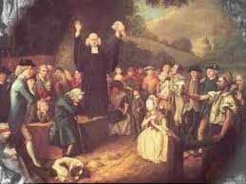
“Sinners in the Hands of An Angry God”
-Name 3 comparisions
-tone and purpose
-Puritan beliefs
-literary devices
-LOOK AT YOUR NOTEBOOK FOR THIS ONE!!!!

Slide 20
REVIEW
1.) What is the difference between mood and tone? How did the written tone of Edward’s words differ from how he actually presented his sermon, “Sinners in the Hands of an Angry God”?
2.) Why did the Puritans separate from the Church of England?

Slide 21
LIT TERMS:
HYPERBOLE:
ANAPHORA:
ETHOS:
APPOSITIVE:
ALLUSION:
ANACHRONISM:
EUPHEMISM:

Slide 22
LIT TERMS:
HYPERBOLE: an exaggeration
I’m so hungry, I could eat a horse!
ANAPHORA: repetition in the beginning of a phrase
I will go. I will fight. I will fun.
ETHOS: when an expert of authority give you info
The preacher is the representative authority for God
APPOSITIVE: a title or description after a noun that gives you more information
Ms Engelbert, my teacher, is weird.
ALLUSION: A reference from literature to something else
She found her holy grail in musical theater.
ANACHRONISM: Taking something from the past and putting it where it doesn’t belong.
They didn’t have helicopters in the American revolution!
EUPHEMISM: Making something sound nicer than what it really is
A stay at home mom might be called a domestic engineer

Slide 23
LITERATURE TIMELINE…
PURITANISM
RATIONALISM
ROMANTICISM
TRANSCENDENTALISM
REALISM
NATURALISM

Slide 24
Puritanism
The Puritan society placed God at the center point of society, and their literature works which were primary diaries and histories expressed God as the central theme. The Puritan writing is very strict and simple.
Bible provides a model for Puritan writing.
Biblical events related with their own lives.
Used writing to find God in their lives

Slide 25
Examples of Puritanism
Sermons, diaries, personal narratives
Jonathan Edwards’ “Sinners in the Hands of an Angry God”
Edward Taylor’s “Huswifery”
Though not written during Puritan times, The Crucible & The Scarlet Letter depict life during the time when Puritan theocracy prevailed.

Slide 26
What is Puritan predestination?
A. God had already chosen who would go to heaven and who would go to hell
B God had already chosen what job and destiny you would have
C God had already decided who you would marry
D Man chooses his own destiny

Slide 27
What is Puritan predestination?
A. God had already chosen who would go to heaven and who would go to hell
B God had already chosen what job and destiny you would have
C God had already decided who you would marry
D Man chooses his own destiny

Slide 28
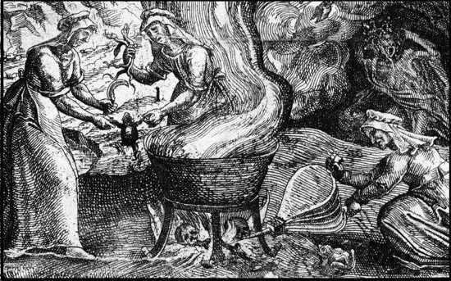
WITCH TESTS!

Slide 29
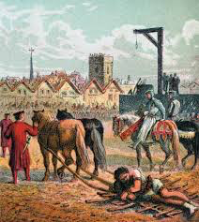
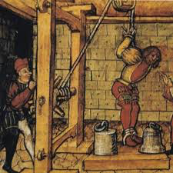
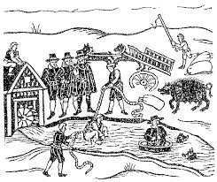
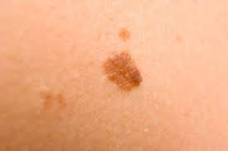
What are these?
How many people were killed during the historic Salem witch trials?

Slide 30
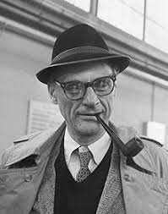
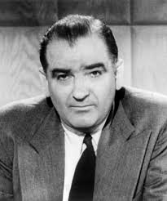
What situation was Arthur Miller contesting when he wrote The Crucible?

Slide 31
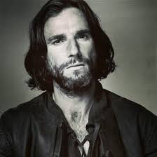
Why doesn’t John Proctor like to go to church?
because his house is far away
he doesn’t believe in God
he doesn’t like the way Parris preaches
he doesn’t want to see Abigail there

Slide 32
Why doesn’t John Proctor like to go to church?
because his house is far away
he doesn’t believe in God
he doesn’t like the way Parris preaches
he doesn’t want to see Abigail there

Slide 33
QUESTION?
Given circumstances are anything that happen before the opening of a play. What pivotal event sets everything in motion?
A Abigail has an affair with John Proctor
B Parris brings Tituba to America
C The girls dance in the woods and get caught; Betty freaks
D Rev. Hale comes to town

Slide 34
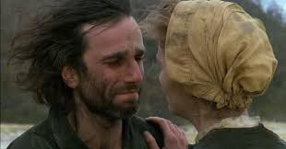
CONFLICTS:
Man vs Man
Man vs Animal
Man vs Himself
Man vs Circumstance
Man vs Society
Can you think of an example from the Crucible that suits each of these types of conflict?

Slide 35
QUESTION
Which is NOT a theme of The Crucible?
love conquers all
mass hysteria
doing anything to save your reputation
religious hypocrisy

Slide 36
QUESTION
Which is NOT a theme of The Crucible?
love conquers all
mass hysteria
doing anything to save your reputation
religious hypocrisy

Slide 37
QUESTION?
Given circumstances are anything that happen before the opening of a play. What pivotal event sets everything in motion?
A Abigail has an affair with John Proctor
B Parris brings Tituba to America
C The girls dance in the woods and get caught; Betty freaks
D Rev. Hale comes to town

Slide 38
WORRIED?
DEFINITELY TAKE THE TIME TO REVIEW THE CRUCIBLE PPT ON THE WEBSITE!

Slide 39
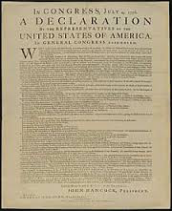
RATIONALISM!!!!!
Dear England,
We’re breaking up. It’s over. I hate you.
Love,
America

Slide 41
GENTRIFICATION

Slide 42
Point/Counterpoint
Can you name the pros and cons of gentrification?

Slide 45
PATRICK HENRY
Who was he?
What was his famous quote?
What was his purpose in speaking at the convention?

Slide 46
RHETORICAL APPEALS
ETHOS: When in the Course of human events, it becomes necessary for one people to dissolve the political bands which have connected them with another, and to assume among the powers of the earth, the separate and equal station to which the Laws of Nature and of Nature's God entitle them, a decent respect to the opinions of mankind requires that they should declare the causes which impel them to the separation.
LOGOS: We hold these truths to be self-evident, that all men are created equal, that they are endowed by their Creator with certain unalienable Rights, that among these are Life, Liberty and the pursuit of Happiness.-
PATHOS: He has plundered our seas, ravaged our Coasts, burnt our towns, and destroyed the lives of our people.

Slide 47
RHETORICAL DEVICES
Allusion | 1.) Instead of stay-at-home-mom/ domestic engineer
B. consonance | 2.) I have a dream…repeated at the beginning
C. assonance | 3.) Jumbo Shrimp
D. antithesis | 4.) repetition of phrases at the end of the lines
E. antistrophe | 5.) Peter Piper picked a peck of pickled peppers
F. oxymoron | 6.) Writing essays was his Achilles’ heel
G. alliteration | 7.) repetition of consonance
H. anaphora | 8.) repetition of vowel sounds
I. euphemism | 9.) “one small step for man, one giant step for mankind”

Slide 48
SLAVERY
What two subjects were predominantly expressed in slave spirituals?
A Christian values and the hardships of slavery
B Cultural myths and familial stories
C Christian values and family heritage
D The hardships of slavery and cultural traditions

Slide 49
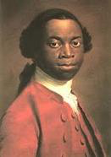
Summarize “The Interesting Life of Oludah Equiano”
-How did he become educated?
-What examples of death did he witness?
-When did he find hope?

Slide 50
SLAVERY
What two subjects were predominantly expressed in slave spirituals?
A Christian values and the hardships of slavery
B Cultural myths and familial stories
C Christian values and family heritage
D The hardships of slavery and cultural traditions

Slide 51
Make sure you review…
MLA FORMAT
IN-TEXT CITATIONS
WORKS CITED

