Slide 1
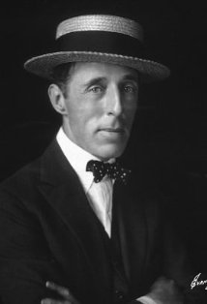
d.W. Griffith: The father of narrative cinema
“To watch his work is like being witness to the beginning of melody, or the first conscious use of the lever or the wheel; the emergence, coordination, and first eloquence of language; the birth of an art: and to realize that this is all the work of one man.” – James Agee
FILM AS LITERATURE
Engelbert Room 423

Slide 2
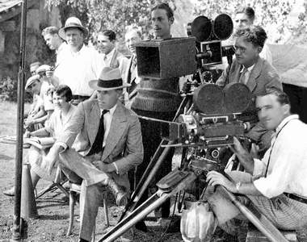
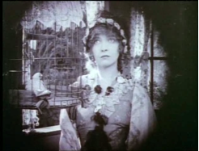
What he did to film
D.W. Griffith came up a formula for appealing to middle class citizens by combining attractions with fictional stories with a moral voice
D.W Griffith changed the role of director to a role with more artistic power
He added more suspense and put the focus on narrative over spectacle bringing us into the transitional era.
Cross-cutting- cutting between two actions that are happening at the same time in two locations, two storyline come together
Iris shot (see picture)
He also experimented with camera angles like the close up to achieve greater narrative/emotional impact

Slide 3
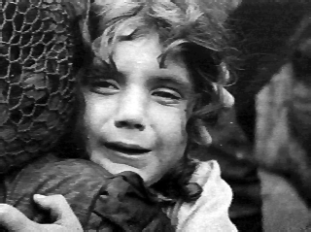
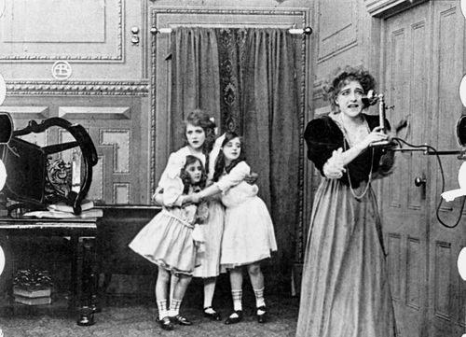
The new narrative
Suspense melodrama consisted of 4 parts 1. narrative begins with stable situation 2. stable situation is disrupted by outside evil power or force 3. forces a counter action 4 concludes story with stability restored
You’ll also typically see the following in his films:
1. Puppies or kittens
2. Women as delicate and innocent, possibly immature or childlike
3. Good guys/men with pet names/nicknames like you might have for a little boy
4. Crosscutting
5. Good vs. Evil

Slide 4
His life
He grew up in the south. His father had been a Confederate soldier in the Civil War.
He went into acting (even though it was a profession looked down upon) for Edison and the Biograph Company
At the time when film was trying to reinvent itself after the Nickelodeons closed and the Board of Censorship went into effect, D.W. Griffith got the chance to step up to trying a hand at directing. He did well at it even. And made many shorts for the Biograph Company before venturing off to create the first feature length film.

Slide 5
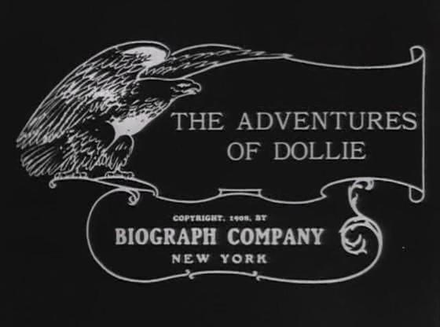
The adventures of dollie: just the beginning
American Mutoscope and Biograph Company, one of the major American motion-picture studios in the early days of filmmaking; it was founded in 1895. The company’s most significant contribution to cinema comes from the work of D.W. Griffith, the first great director, who developed the art of the cinema during his five years at Biograph.
The Adventures of Dollie is a 1908 American silent film directed by D. W. Griffith. It was Griffith's debut film as a director.
He had been asked to direct a film and decided to do it on the condition that he not lose his acting job (he never went back to acting).

Slide 6
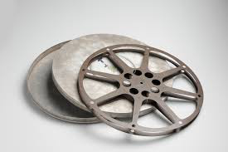
Single anD DOUBLE REEL
-Griffith often used serial novels (short episodics) that fit one-reel screenings of early cinema
-Each reel movie was 10-20 minutes long.
-Griffith’s adaptation of the Victorian poem “Enoch Arden” was a two-reel movie. Originally, he producer was worried the audience wouldn’t sit for a full 30 minutes!
-It was an astounding success, which paved the way for longer films.

Slide 7
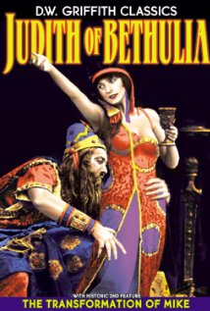
Moving towards feature length films
Judith of Bethulia (1914) is a 61 minute film produced and directed by D. W. Griffith. The film was the first feature-length film made by pioneering film company Biograph, although the second that Biograph released.
Shortly after its completion and a disagreement Griffith had with Biograph executives on making more feature-length films, Griffith left Biograph, and took the entire stock company with him. Biograph delayed the picture's release until 1914, after Griffith's departure, so that it would not have to pay him in a profit-sharing agreement they had.
After Griffith left, he continued making longer feature length films though their success is debatable. He is still considered the most important man in film history because of his contributions.

Slide 8
What comes next
1907- 1913 move to Hollywood for good weather to film year round
Mutual vs Ohio (1915)- U.S. Supreme Court declared state censorship in motion pictures constitutional. Film is not protected by the 1st amendment (overturned in 1952 and film is considered an art form and is eligible for 1st amendment protection)
What makes D.W. Griffith more important than the other milestones we’ve had in film history?
How does D.W. Griffith’s contributions compare to others in film history?
http://archive.org/details/TheAdventuresOfDollie
http://www.britannica.com/EBchecked/topic/65904/Biograph-Company
http://en.wikipedia.org/wiki/Judith_of_Bethulia

