Slide 1
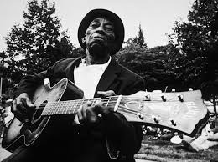
Slave Narratives and the Blues
Engelbert 2015

Slide 2
To think about…
Last class we examined multimedia sources about how slavery became the norm in America. It was illegal for slaves to learn to read and write, so they turned to music to express their feelings and create a “narrative record” of their experiences.
What themes do you think were present in African American music in early America?

Slide 3
Slave Spirituals
https://www.youtube.com/watch?v=1JtD_YpyXYU
-Religious songs created by enslaved African Americans that capture Christian values and the hardships of slavery.

Slide 4
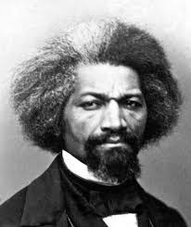
Spirituals Continued…
Spirituals sometimes provided comfort and eased the boredom of daily tasks. They were an expression of spiritual devotion and a yearning for freedom from bondage. Sometimes they were a means of releasing pent up emotions and expressing sorrow. Frederick Douglass, a former slave wrote, "I did not, when a slave, fully understand the deep meaning of those rude and apparently incoherent songs. I was, myself, within the circle, so that I could then neither hear nor see as those without might see and hear. They breathed the prayer and complaint of souls overflowing with the bitterest anguish. They depressed my spirits and filled my heart with ineffable sadness...The remark in the olden time was not unfrequently made, that slaves were the most contented and happy laborers in the world, and their dancing and singing were referred to in proof of this alleged fact; but it was a great mistake to suppose them happy because they sometimes made those joyful noises. The songs of the slaves represented their sorrows, rather than their joys. Like tears, they were a relief to aching hearts."

Slide 5
WHAT IS THE BLUES?
Background Article
12 Bar Blues

Slide 6
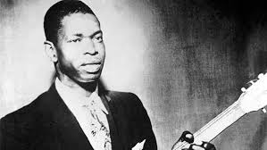
Elmore James
https://www.youtube.com/watch?v=aKo80b-QfK0

Slide 7
YOUR ASSIGNMENT
Write a song or poem inspired by slave spirituals or blues music that centers around the theme of “struggle”.
You could write your piece about a personal struggle you’ve had to overcome, a societal ill, or capture the tone of one of the pieces of literature we’ve examined this unit (early Americans, Equiano, etc.) You could also look at any of the WPA narratives for inspiration.

Slide 8
What does this look like?
-Original lyrics; min. of 16 lines -Can follow any musical or rhyme structure -Sing and perform to background track -Record audio only or option to videotape performance to submit to google drive folder | -Original lyrics; min. of 16 lines -Can follow any musical or rhyme structure -Create a moving powerpoint, Imovie, or other computer program with inspired images. Choose song to underscore your short “illustrated poem” and save as a .mov file or mp4. Submit to google drive folder.
OPTION 1
OPTION 2

Slide 9
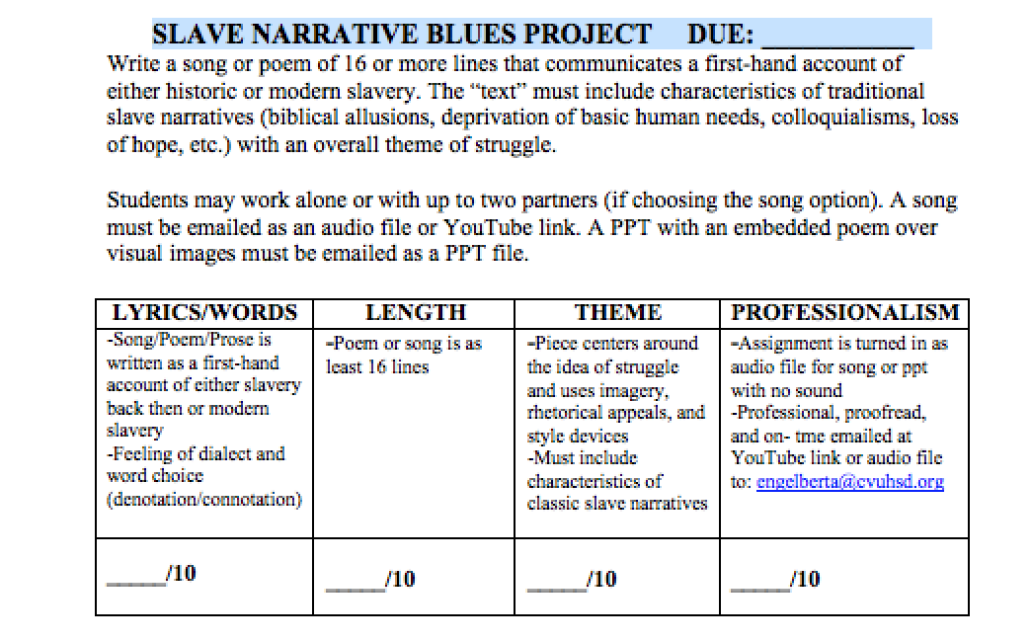
RUBRIC

