Slide 1
AMA Exit Portfolio
Engelbert’s Sample

Slide 2
ARTIFACTS

Slide 3
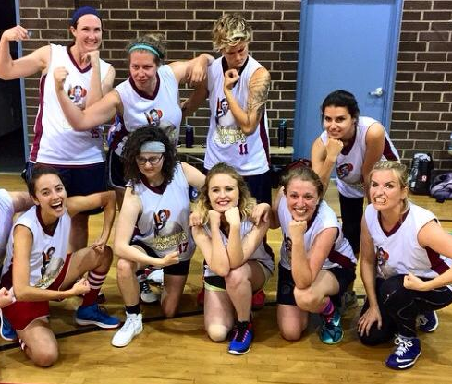
HEALTH

Slide 4
IMPROV/WRITING

Slide 5
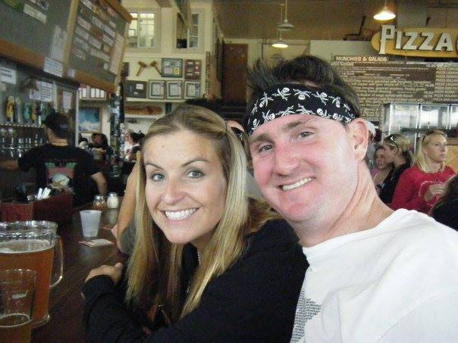
LOST ONES
https://vimeo.com/209789627

Slide 6
ACADEMIC EVIDENCE
Come little school children, and sit down and learn,
For teacher will give gifts to those who seem to yearn.
Come little soldiers, and stand up tall and brave,
For general will applaud you, and lives you’ll surely save.
Come, little elders, and walk into the light,
For God will accept you for doing what is right.

Slide 7
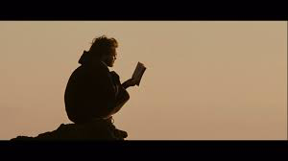
LITERARY PASSAGE

Slide 8
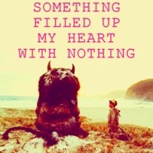
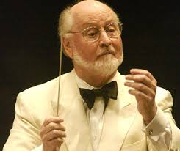
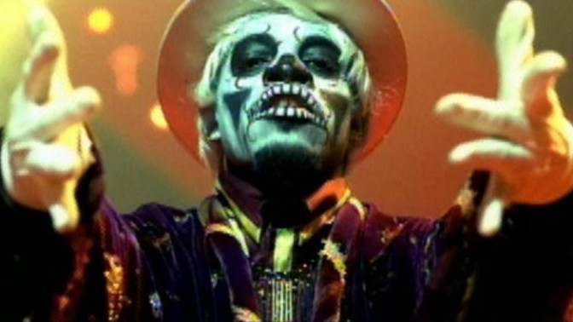
SOUNDTRACK
John Williams
https://www.youtube.com/watch?v=ZaA0IctGTDw
Arcade Fire
Outkast

Slide 9
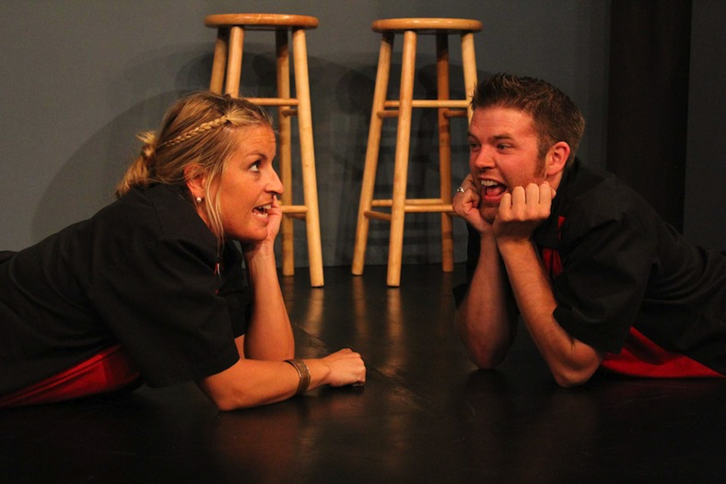
My VERSE
Do your work. Live your dreams. Live your dreams in your work...

Slide 10
ART PORTFOLIO:
https://www.youtube.com/watch?v=QXD_HxmYgvA
https://drive.google.com/drive/shared-with-me
https://vimeo.com/123110775

